Slide 1

Fuels and uses

Slide 2

Outline
Fuels efficiency
Fuels for electricity
Fuels for transport

Slide 3

Choosing a fuel
Fuel needs to be fit for purpose
Factors to consider:
Energy released per unit mass or volume and emissions
Availability and cost of fuel
Ease of transport
Hazards to people and the environment associated with its use and its waste products
Social, economic, cultural and political values that can affect the choice of the fuel

Slide 4
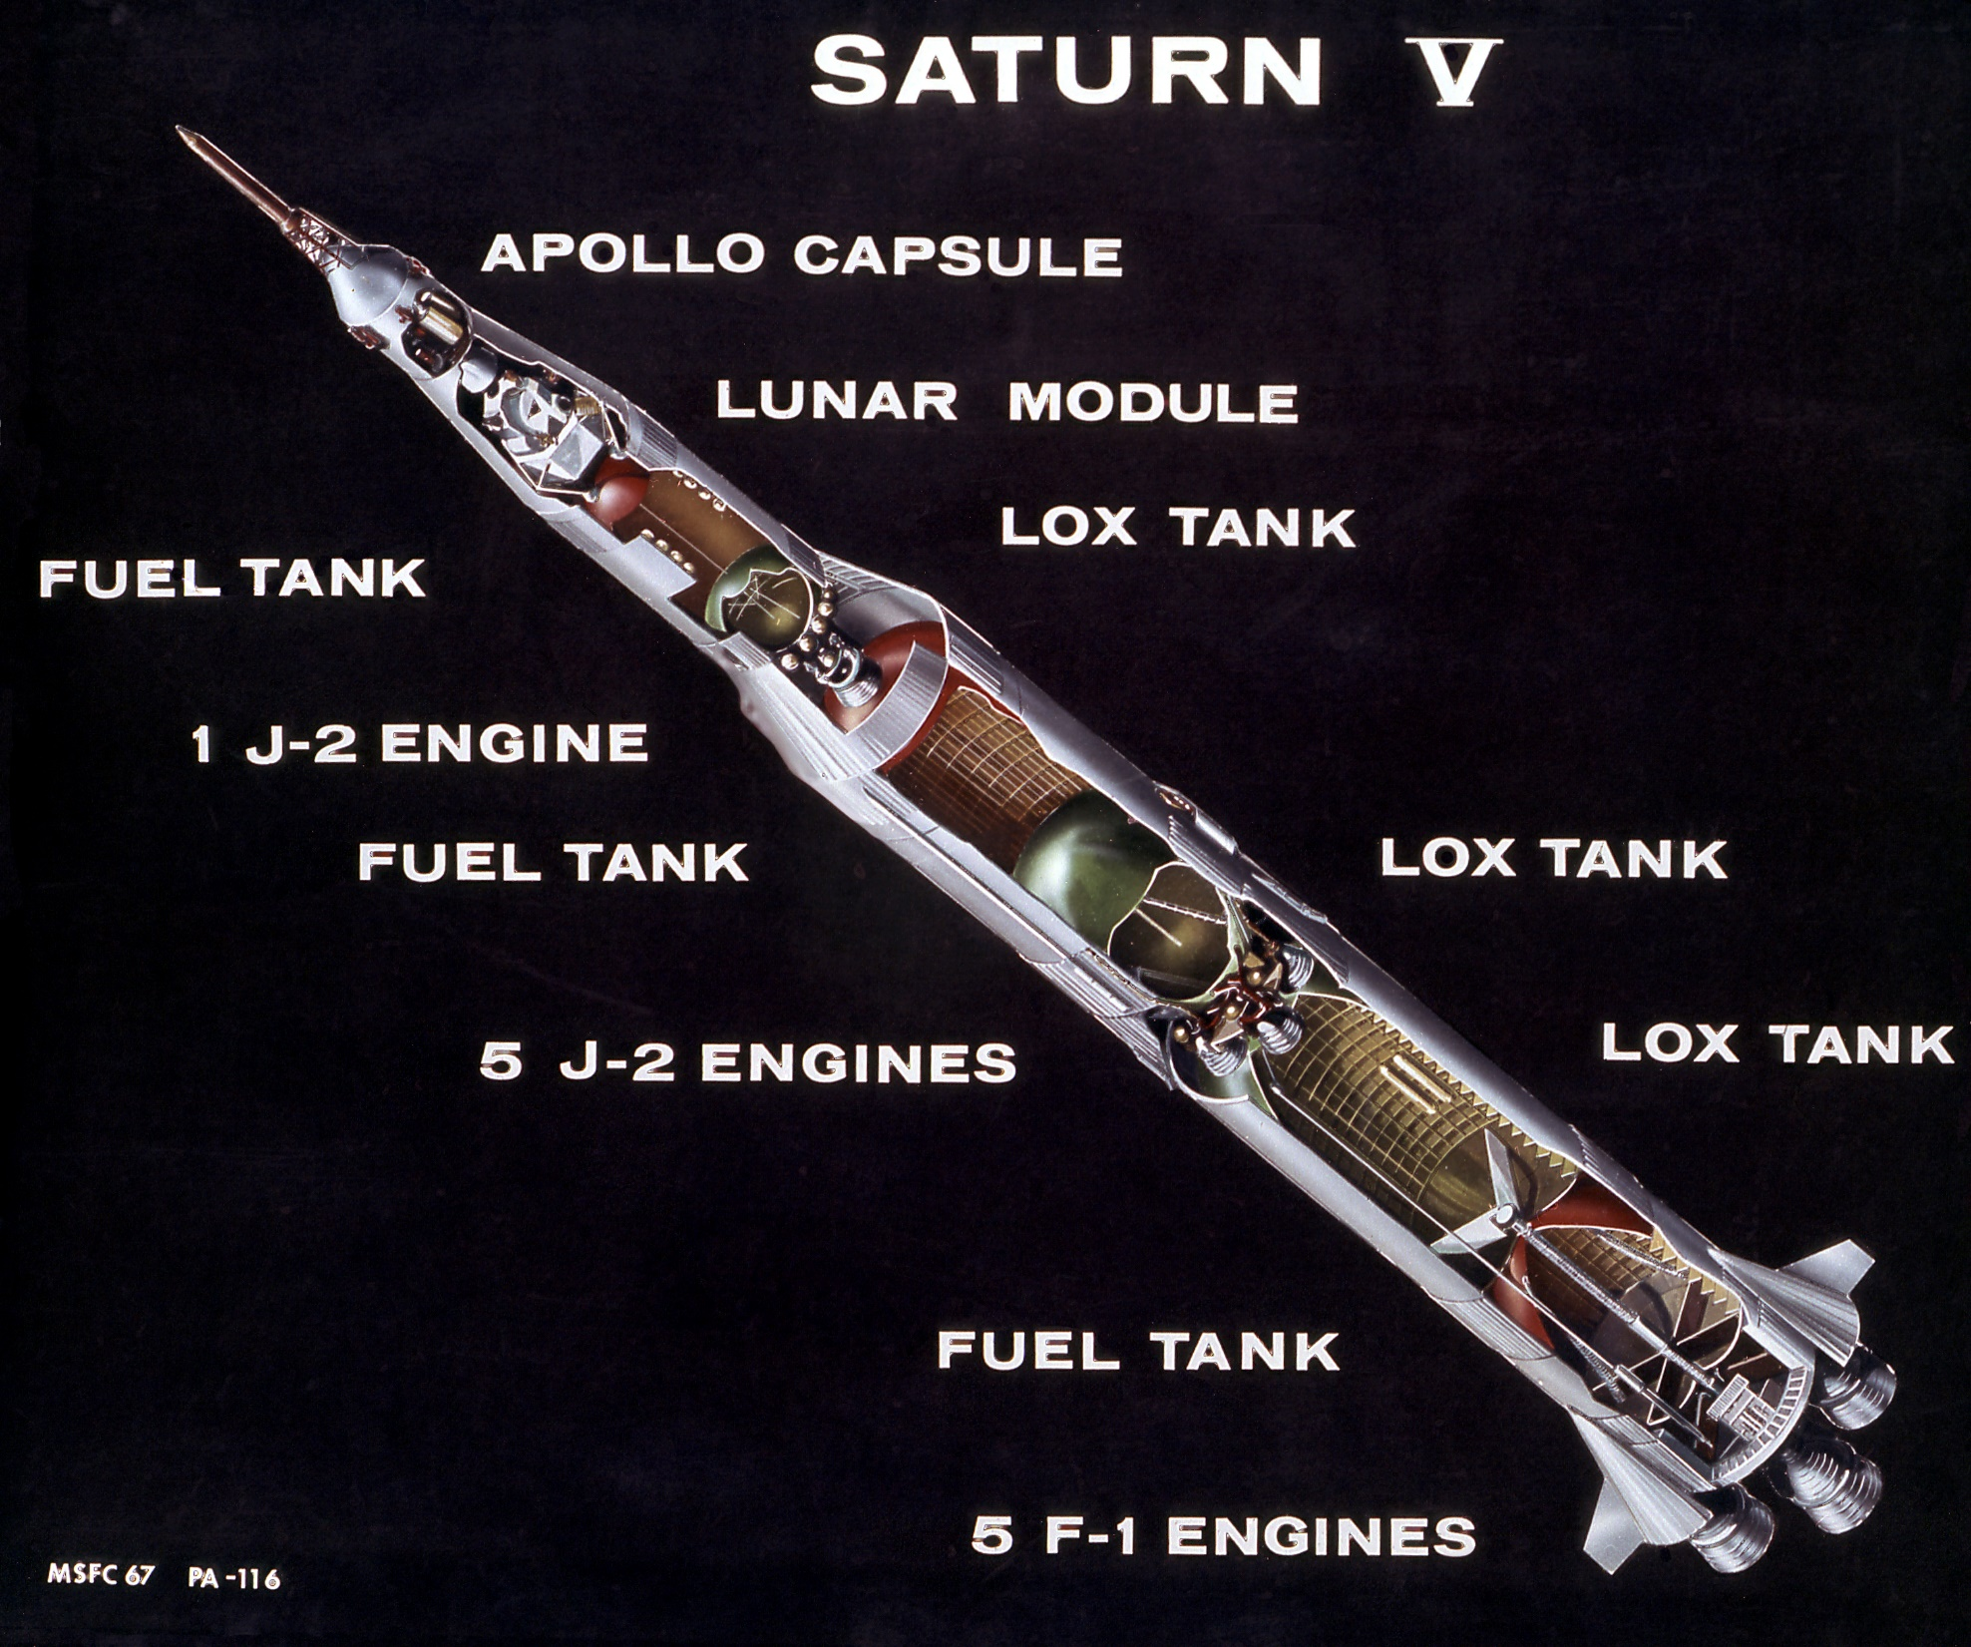
Intended use and fuel choices
NASA used liquid hydrogen to fuel the Saturn rockets
It produces a large quantity of energy per gram

Slide 5
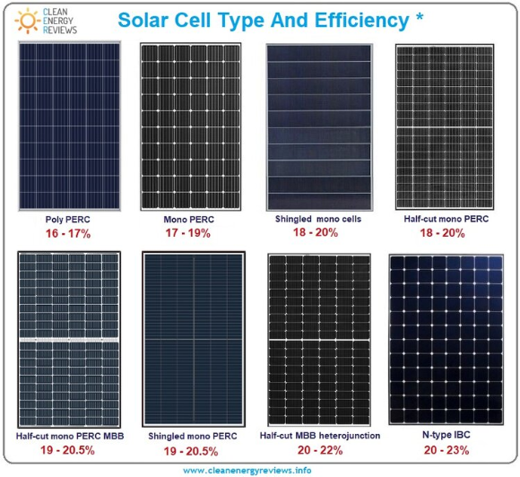
Fuel efficiency
Percentage of the energy converted to useful energy
E.g if a roof top solar panels have an efficiency of 17 %, so 17 % of the energy of the sun is converted into electrical energy and 83 % is mostly converted to heat energy (simply increasing the temperature of the cell)

Slide 6
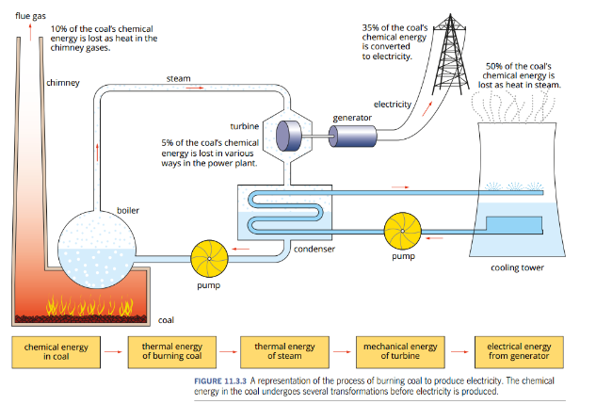
Electricity production
From coal
Three quarters of Australian electricity is from coal
The equation for the combustion of coal is:
C_{(s)} + O_{2(g)} → CO_{2(g)}
Energy released: ~ 32 kJ g⁻¹
Overall efficiency is 30 -40 % (remainder is lost as heat)

Slide 7
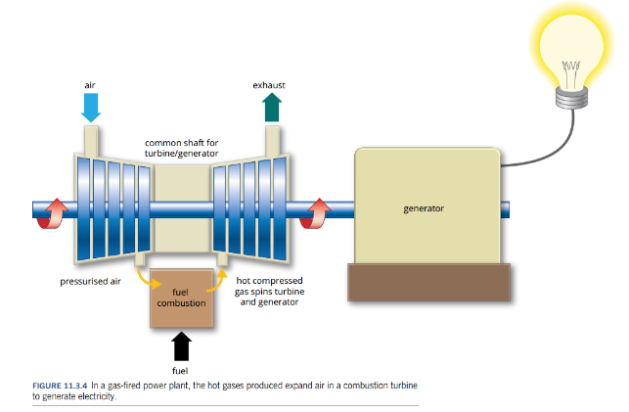
Electricity production
From natural gas
Used in WA, burn methane and other small alkanes
Composition varies but is mostly methane:
CH_{4(g)} + 2O_{2(g)} → CO_{2(g)} + 2H₂O_{(g)}
Energy released: ~ 55.6 kJ g⁻¹
Overall efficiency just over 40 %, and releases less emission

Slide 8
Electricity production
From biogas
New renewable source of methane
Composition of methane:
CH_{4(g)} + 2O_{2(g)} → CO_{2(g)} + 2H₂O_{(g)}
Small scale operations typically located at the site the gas is produced (e.g. sewage plants, large animal farms)

Slide 9
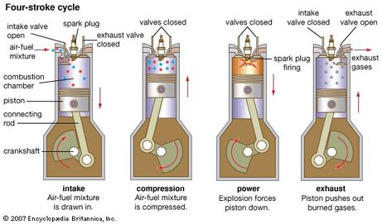
Fuel for transport
From petrol
Mixture of hydrocarbons including octane
Composition varies but combustion of octane is:
2C₈H_{18(g)} + 25O_{2(g)} → 16CO_{2(g)} + 18H₂O_{(g)}
Energy released: ~ 47.8 kJ g⁻¹
Overall efficiency can be as high as 25 %

Slide 10
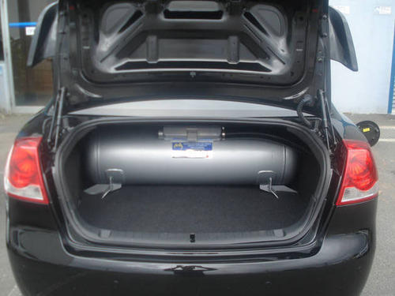
Fuel for transport
From liquid petroleum gas (LPG)
Mixture of hydrocarbons mostly propane
Composition varies but combustion of propane is:
C₃H_{8(g)} + 5O_{2(g)} → 3CO_{2(g)} + 4H₂O_{(g)}
Energy released: ~ 50.5 kJ g⁻¹
Use a standard petrol engine fitted with gas tank and a modified fuel injection system
LPG is cheaper then petrol but the modifications are expensive and the tank takes up a lot of space

Slide 11
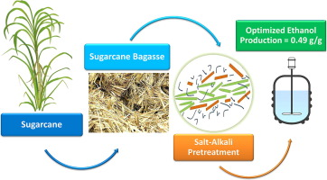

Fuel for transport
From bioethanol
Australia is reliant on fuel imports, bioethanol production could see more production here
Composition varies but combustion of ethanol is:
C₂H₅OH_{(l)} + 3O_{2(g)} → 2CO_{2(g)} + 3H₂O_{(g)}
Energy released: ~ 29.7 kJ g⁻¹
Energy content of ethanol is about 62 % that of petrol, so need much greater of volume of ethanol
Ethanol is already partly oxidised

Slide 12
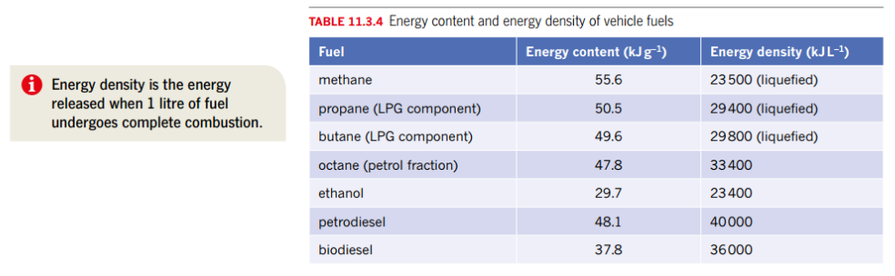
Fuel efficiency

Slide 13

On going work
Pearson 11.3 review and the chapter 11 review
STAWA sets 29

